Slide 1
Learning Management System
By: Kyle Vessey, Brandon Popson, Nhat Nguyen,Joshua Reese and Hung Ngo . Using “Ruby on Rails”

Slide 2
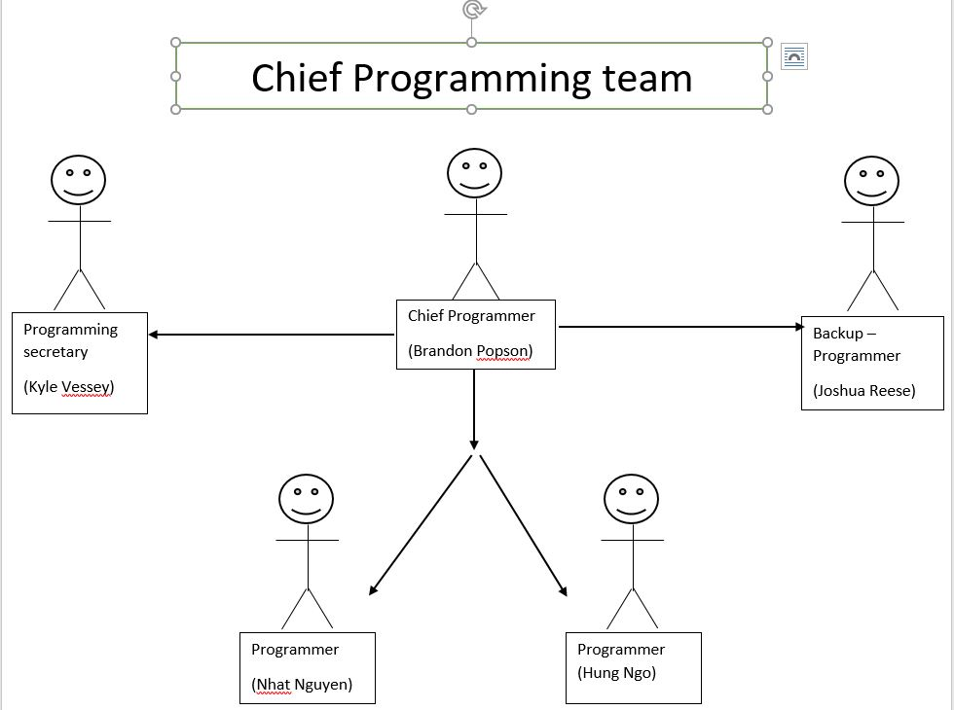
Team organization

Slide 3
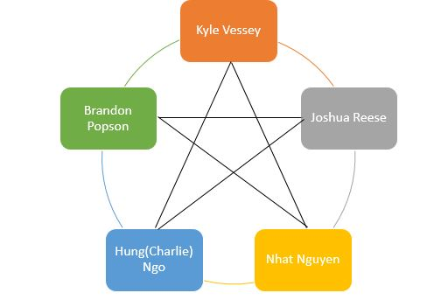
Team Model – (Democratic)

Slide 4
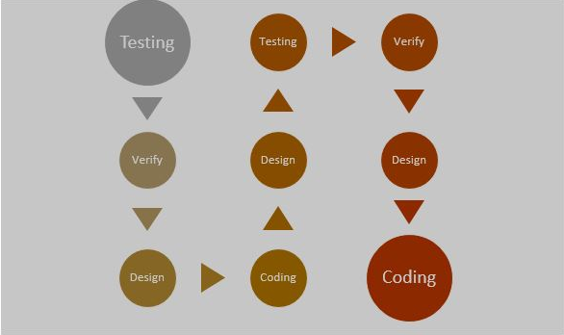
Iterative Life cycle

Slide 5
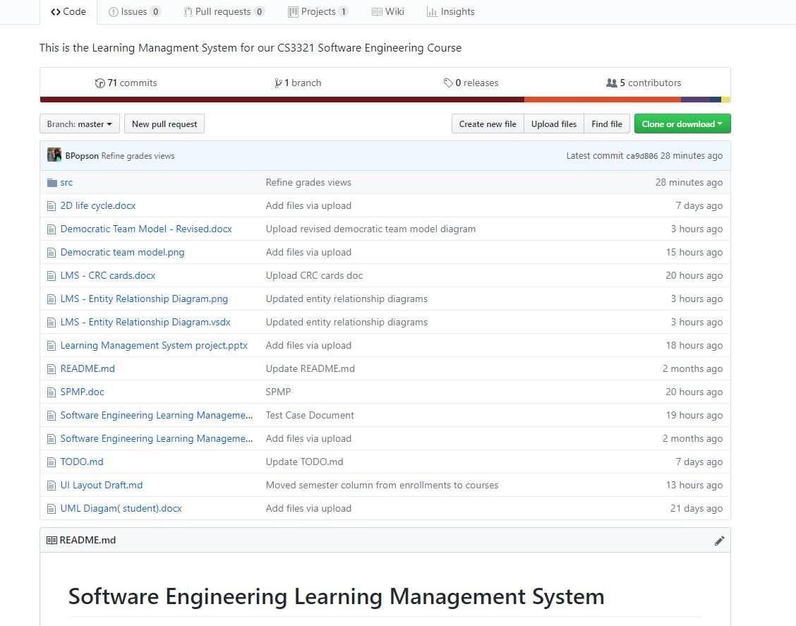
GitHub

Slide 6
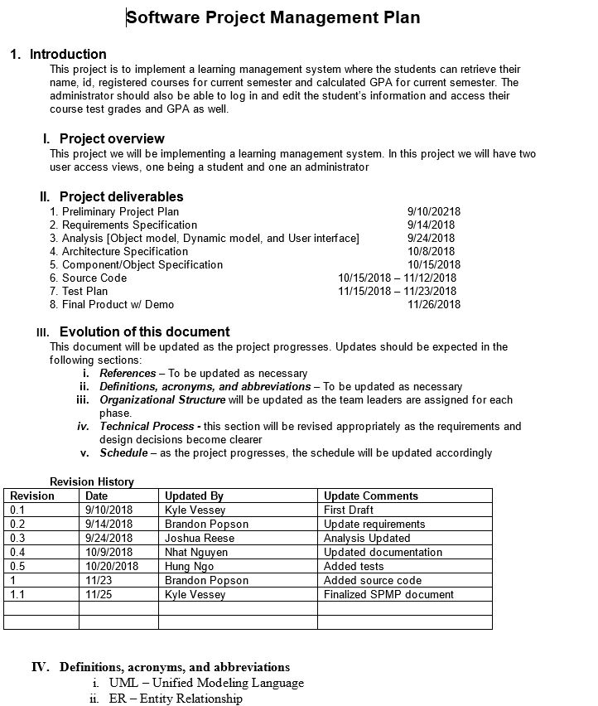
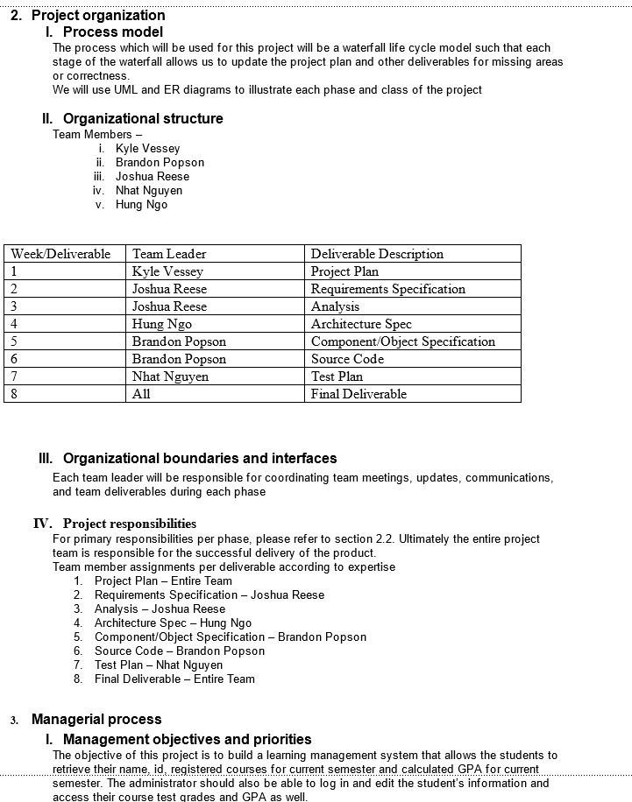
Software project management plan

Slide 7
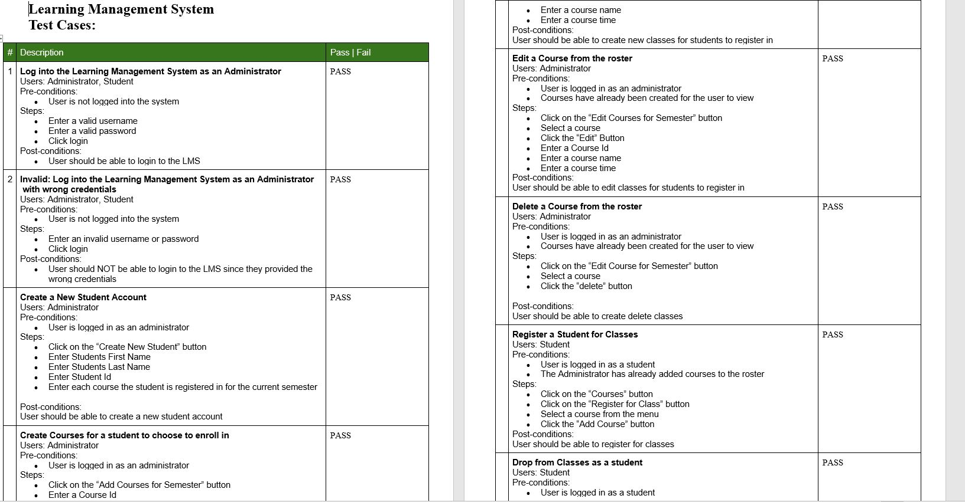
Test Case

Slide 8
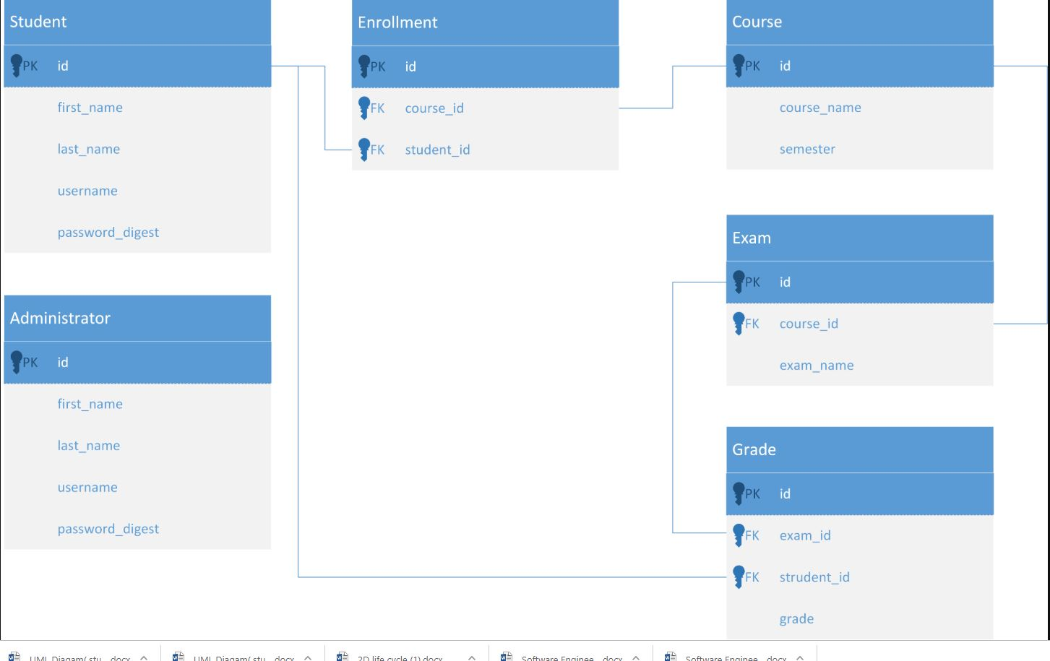
Relationship Diagram

Slide 9
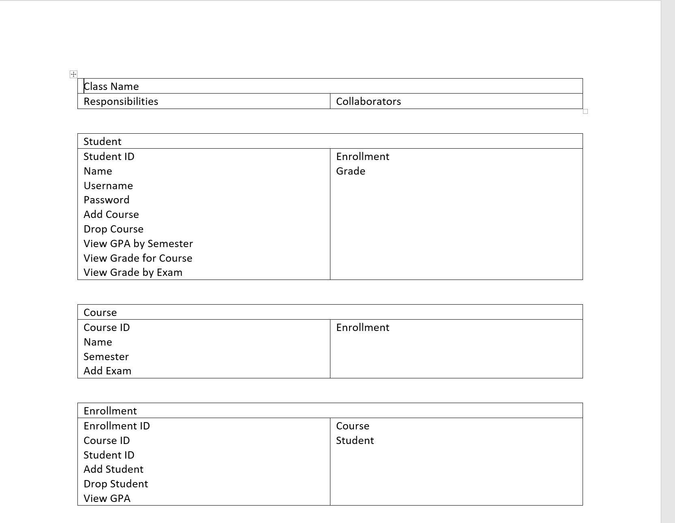
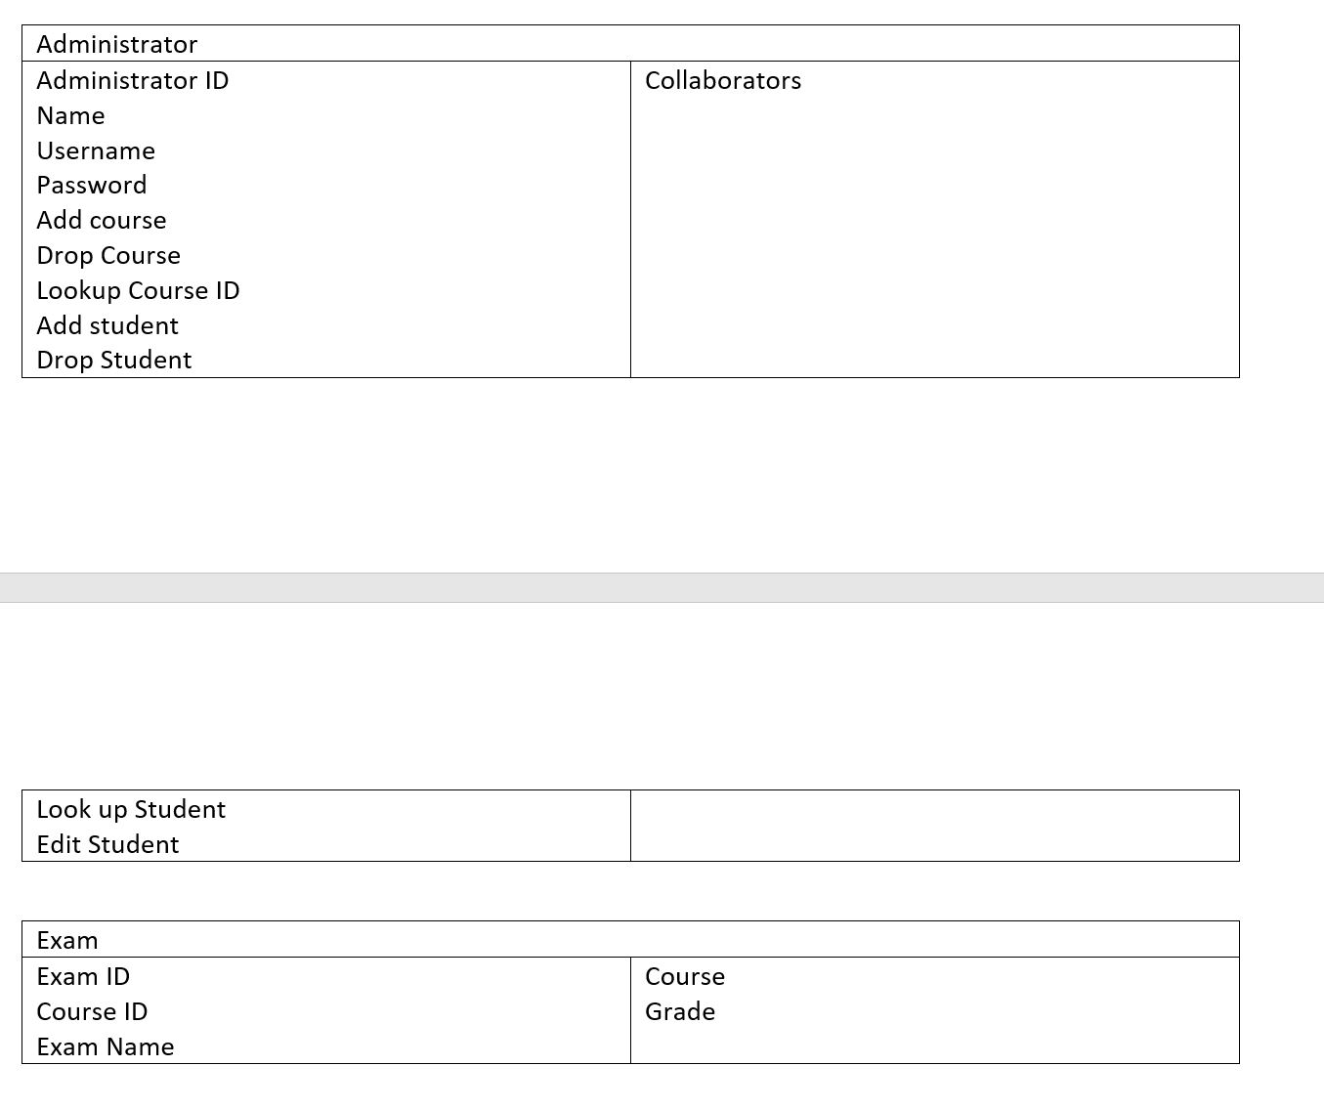
Class-responsibility-collaboration (CRC) cards

Slide 10
Fin

